Slide 1


Amateur Extra Licensing Class
Optos & OpAmps Plus Solar
Presented by
W5YI
Arlington, Texas

Slide 2
Amateur Radio Extra Class
Element 4 Course Presentation
ELEMENT 4 Groupings
  Rules & Regs
  Skywaves & Contesting
  Outer Space Comms
  Visuals & Video Modes
  Digital Excitement with Computers & Radios
  Modulate Your Transmitters
  Amps & Power Supplies
  Receivers with Great Filters

Slide 3
Amateur Radio Extra Class
Element 4 Course Presentation
ELEMENT 4 Groupings
  Oscillate & Synthesize This!
  Circuits & Resonance for All!
  Components in Your New Rig
  Logically Speaking of Counters
  Optos & OpAmps Plus Solar
  Test Gear, Testing, Testing 1,2,3
  Antennas
  Feedlines & Safety

Slide 4
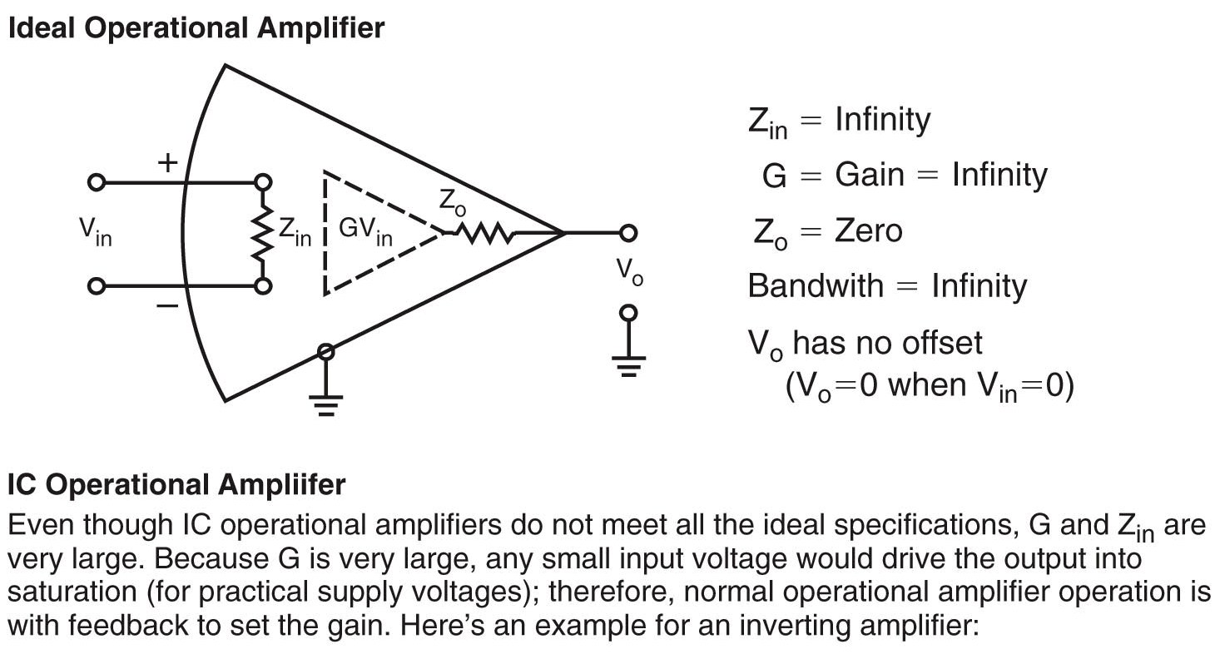
Amateur Radio Extra Class
Optos & OpAmps Plus Solar
E7G14… An operational amplifier is a high-gain, direct-coupled differential amplifier whose characteristics are (response is) determined by components external to the amplifier.
E7G01… The values of capacitors and resistors external to the op-amp determine the gain and frequency characteristics of an op-amp RC active filter.
Operational Amplifier Basics

Slide 5
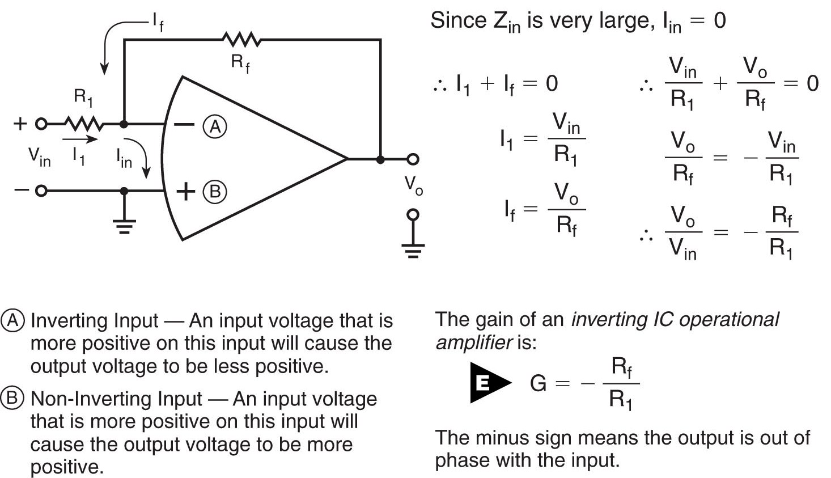
Amateur Radio Extra Class
Optos & OpAmps Plus Solar
E7G02… Ringing in a filter is caused by frequency and phase response of the filter (non linear group delay).
Operational Amplifier Basics
cont.

Slide 6
Amateur Radio Extra Class
Optos & OpAmps Plus Solar
E7G03… The advantages of using an op-amp instead of LC elements in an audio filter is that Op-amps exhibit gain rather than insertion loss.
E7G04… A polystyrene capacitor is best suited for use in high-stability op-amp RC active filter circuits.
E7G05… Unwanted ringing and audio instability can be prevented in a multi-section op-amp RC audio filter circuit by restricting both gain and Q.
E7G06… Standard capacitor values are chosen first, then the resistances are calculated, and resistors of the nearest standard value selected for the external components in an op-amp RC active filter.

Slide 7
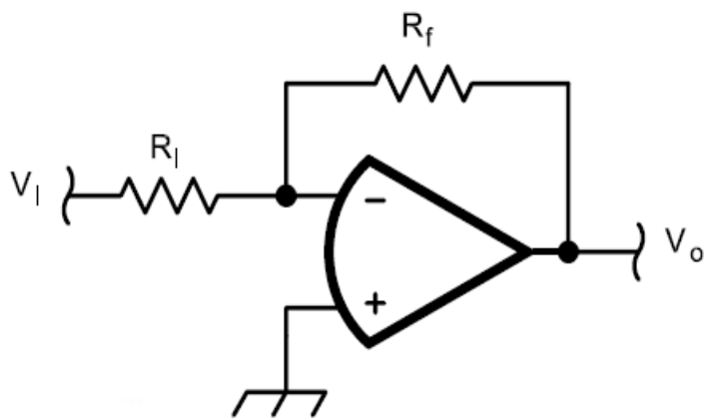
Amateur Radio Extra Class
Optos & OpAmps Plus Solar
E7G07… The most appropriate use of an op-amp RC active filter is as an audio receiving filter.
Ideally, an op amp has infinite input impedance (Z_{I}), zero output impedance (Z_{O}) and an open loop voltage gain (A_{V}) of infinity. Obviously, practical op amps do not meet these specifications, but they do come closer than most other types of amplifiers.
The gain of an op amp is the function of the input resistor and the feed back resistor. Gain in calculated by dividing the input resistor R_{I} value into the feedback resistor R_{F}. In figure E7-4 if the input resistor,R₁, is 10,000 ohms and the feedback resistor ,R_{F}, 1s 1,000,000 ohms the gain would be 1,000,0000 / 10,000 or a gain of 100. The output is inverted in this configuration when the signal is feed into the – pin of the op amp. This is the most commonly used configuration. The op amp can be configured in a non inverting mode so the out put signal is the same polarity as the input signal

Slide 8
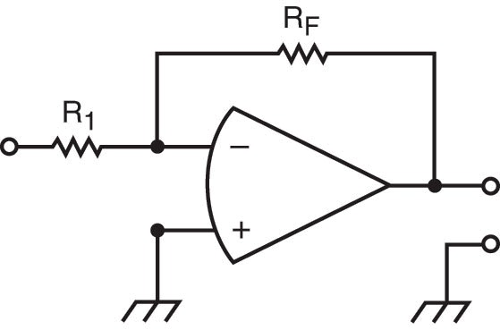
Amateur Radio Extra Class
Optos & OpAmps Plus Solar
E7G08… A Sallen-Key (named after the equation designers) is a type of active op-amp filter circuit.
E7G09… The voltage gain that can be expected from the circuit in Figure E7-4 when R₁ is 10 ohms and R_{F} is 470 ohms is 47.
(The gain is actually -47 since the output is inverted, that is the output polarity is opposite the input polarity)
Figure E7-4
Gain = R_{F} / R₁
470 / 10
47

Slide 9
Amateur Radio Extra Class
Optos & OpAmps Plus Solar
E7G10… The gain of a theoretically ideal operational amplifier does not vary with frequency.
E7G11… The output voltage of the circuit shown in Figure E7-4 if R₁ is 1000 ohms, R_{F} is 10,000 ohms, and 0.23 volts is applied to the input is – 2.3 volts.
Gain = R_{F} / R₁
10,000/1000
10
Output Voltage = Input Voltage x Gain
.23 volts x 10
- 2.3 volts
Figure E7-4
(Remember this operational amplifier configuration is an inverting operational amplifier)

Slide 10
Amateur Radio Extra Class
Optos & OpAmps Plus Solar
E7G12… The voltage gain that can be expected from the circuit in Figure E7-4 when R1 is 1800 ohms and RF is 68 kiliohms is 38.
E7G13… The voltage gain that can be expected from the circuit in Figure E7-4 when R₁ is 3300 ohms and R_{F} is 47 kiliohms is 14.
Gain = R_{F} / R₁
68,000/1800
37.77
Figure E7-4
Gain = R_{F} / R₁
47,000/3300
14.24

Slide 11
Amateur Radio Extra Class
Optos & OpAmps Plus Solar
E7G15… The term "op-amp input-offset voltage" refers to the potential between the amplifier input terminals of the op-amp in a closed-loop condition.
Closed loop condition means a feedback loop is present around the amplifier.
E7G16… The typical input impedance of an integrated circuit op-amp is Very high.
E7G17… The typical output impedance of an integrated circuit op-amp is Very low.
E6F01… Photoconductivity is the increased conductivity of an illuminated semiconductor.

Slide 12
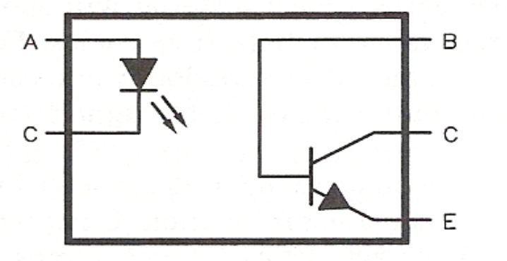
Amateur Radio Extra Class
Optos & OpAmps Plus Solar
E6F02… The conductivity of a photoconductive material increases when light shines on it.
    In other words the resistance decreases
E6F04… An LED and a phototransistor in the same package is an optoisolator.
E6F03… The most common configuration for an optocoupler is an LED and a phototransistor.
Optocoupler and Optoisolator are terms that are used interchangeably for the same device.

Slide 13
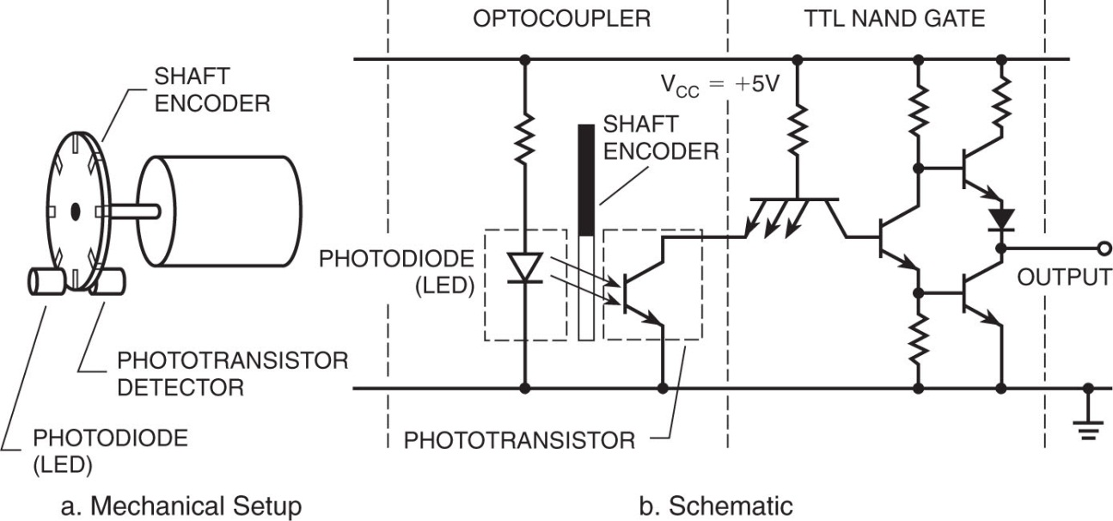
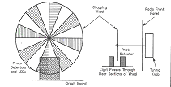
Amateur Radio Extra Class
Optos & OpAmps Plus Solar
E6F05… An optical shaft encoder is an array of optocouplers whose light transmission path is controlled (interrupted) by a rotating wheel.
Optocoupler Used for Shaft Encoder
This drawing illustrates the operation of an optical shaft encoder, often used as a tuning mechanism on modern tranceivers.

Slide 14
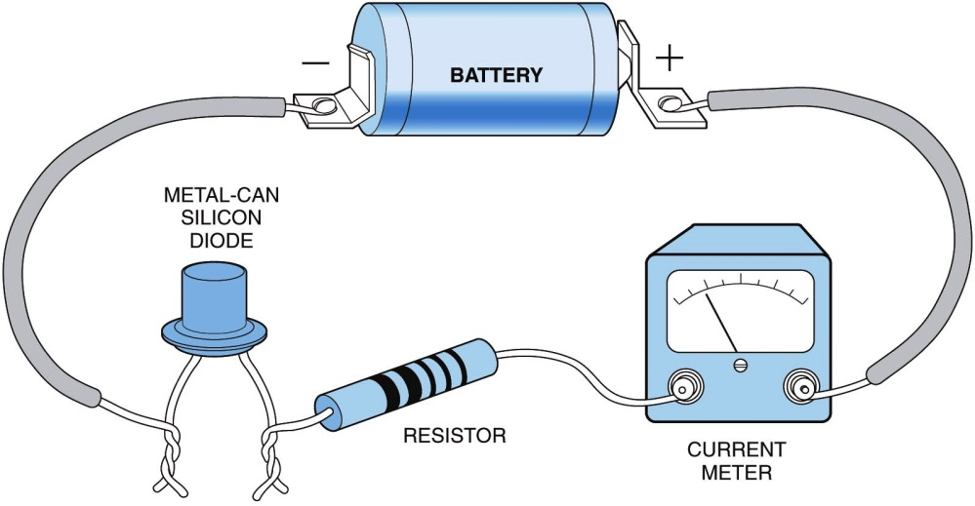
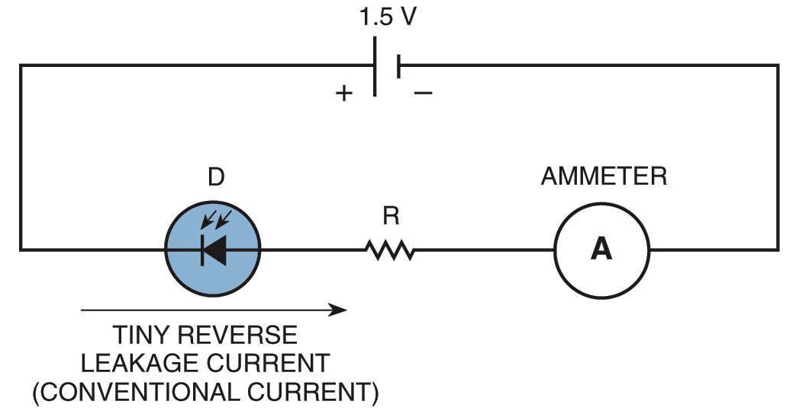
Amateur Radio Extra Class
Optos & OpAmps Plus Solar
E6F06… The resistance of the crystalline solid varies when light shines on it because of the photoconductive effect.
E6F07… Cadmium sulfide will exhibit the greatest photoconductive effect when illuminated by visible light.
Basics for a Photodiode……
Physical circuit
Schematic Diagram

Slide 15
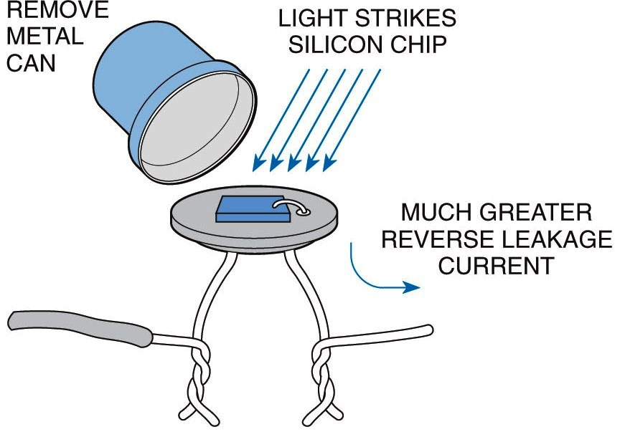
Amateur Radio Extra Class
Optos & OpAmps Plus Solar
……Basics for a Photodiode
A Photodiode is like an ordinary p-n junction diode with a window to admit light. The light greatly increases reverse leakage current.

Slide 16
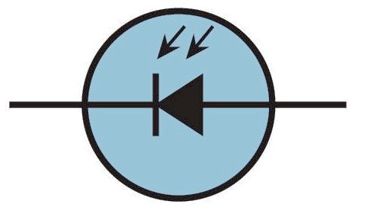
Amateur Radio Extra Class
Optos & OpAmps Plus Solar
E6F08… Lead sulfide will exhibit the greatest photoconductive effect when illuminated by infrared light.
E6F09… A crystalline semiconductor is affected the most by photo-conductivity when compared to heavy metal, ordinary metal, or a liquid semiconductor.
……Basics for a Photodiode
Schematic Symbol of Photodiode

Slide 17
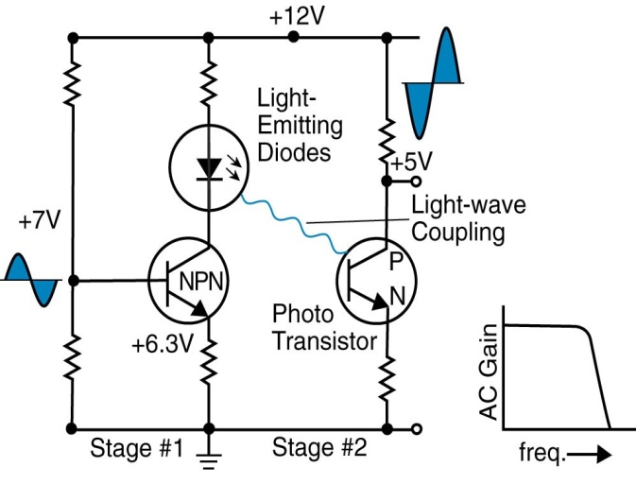
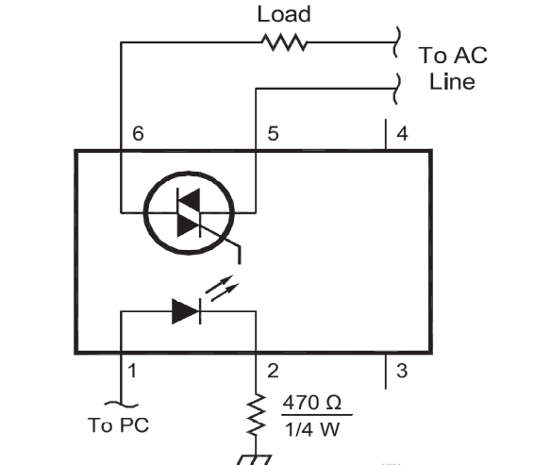
Amateur Radio Extra Class
Optos & OpAmps Plus Solar
E6F10… A characteristic of optoisolators that are often used in power supplies is that they have very high impedance between the light source and the phototransistor.
E6F11… Because optoisolators provide a very high degree of electrical isolation between a control circuit and a power circuit it makes them suitable for use with a triac to form the solid-state equivalent of a mechanical relay for 120 V AC household circuit.
This makes them an excellent choice for controlling high voltages with a low isolated voltage.
Optical Coupling
Optoisolator for 120 Volts AC

Slide 18
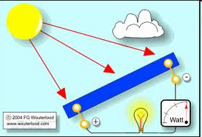
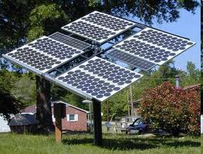

Amateur Radio Extra Class
Optos & OpAmps Plus Solar
E6F12… A Gallium arsenide photovoltaic cell has the highest efficiency.
E6F14… The approximate open-circuit voltage produced by a fully-illuminated silicon photovoltaic cell 0.5 Volts.
E6F15… Electrons absorb the energy from light falling on a photovoltaic cell.
Twenty seven cells would be required to produce 13.5 volts for charging a 12 volt battery.

Slide 19
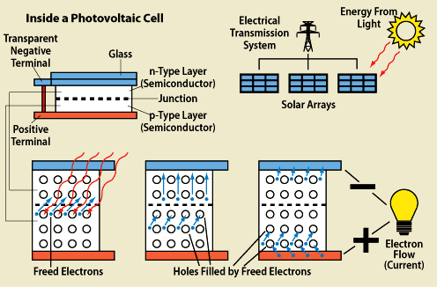
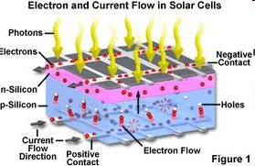
Amateur Radio Extra Class
Optos & OpAmps Plus Solar
E6F13… Silicon is the most common type of photovoltaic cell used for electrical power generation.

Slide 20

Element 4 Extra Class
Question Pool
  Optops & OpAmps Plus Solar
Valid July 1, 2008
Through
June 30, 2012

Slide 21
E7G14 What is an operational amplifier?
A high-gain, direct-coupled differential amplifier whose characteristics are determined by components external to the amplifier
A high-gain, direct-coupled audio amplifier whose characteristics are determined by components external to the amplifier
An amplifier used to increase the average output of frequency modulated amateur signals to the legal limit
A program subroutine that calculates the gain of an RF amplifier

Slide 22
E7G01 What determines the gain and frequency characteristics of an op-amp RC active filter?
The values of capacitors and resistors built into the op-amp
The values of capacitors and resistors external to the op-amp
The input voltage and frequency of the op-amp's DC power supply
The output voltage and smoothness of the op-amp's DC power supply

Slide 23
E7G02 What causes ringing in a filter?
The slew rate of the filter
The bandwidth of the filter
The frequency and phase response of the filter
The gain of the filter

Slide 24
E7G03 What are the advantages of using an op-amp instead of LC elements in an audio filter?
Op-amps are more rugged and can withstand more abuse than can LC elements
Op-amps are fixed at one frequency
Op-amps are available in more varieties than are LC elements
Op-amps exhibit gain rather than insertion loss

Slide 25
E7G04 Which of the following capacitor types is best suited for use in high-stability op-amp RC active filter circuits?
Electrolytic
Disc ceramic
Polystyrene
Paper dielectric

Slide 26
E7G05 How can unwanted ringing and audio instability be prevented in a multi-section op-amp RC audio filter circuit?
Restrict both gain and Q
Restrict gain, but increase Q
Restrict Q, but increase gain
Increase both gain and Q

Slide 27
E7G06 What steps are typically followed when selecting the external components for an op-amp RC active filter?
Standard capacitor values are chosen first, the resistances are calculated, and resistors of the nearest standard value are used
Standard resistor values are chosen first, the capacitances are calculated, and capacitors of the nearest standard value are used
Standard resistor and capacitor values are used, the circuit is tested, and additional resistors are added to make any needed adjustments
Standard resistor and capacitor values are used, the circuit is tested, and additional capacitors are added to make any needed adjustments

Slide 28
E7G07 Which of the following is the most appropriate use of an op-amp RC active filter?
As a high-pass filter used to block RFI at the input to receivers
As a low-pass filter used between a transmitter and a transmission line
For smoothing power-supply output
As an audio receiving filter

Slide 29
E7G08 Which of the following is a type of active op-amp filter circuit?
Regenerative feedback resonator
Helical resonator
Gilbert cell
Sallen-Key

Slide 30
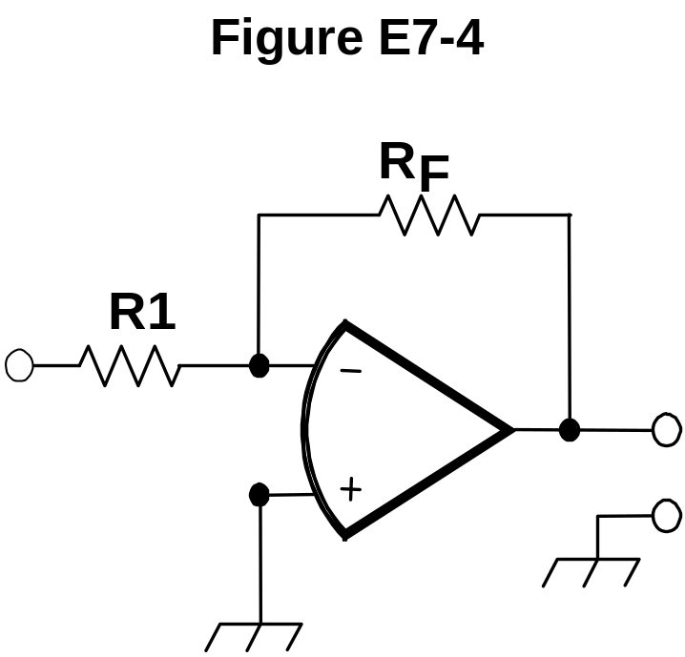
E7G09 What voltage gain can be expected from the circuit in Figure E7-4 when R1 is 10 ohms and RF is 470 ohms?
0.21
94
47
24

Slide 31
E7G10 How does the gain of a theoretically ideal operational amplifier vary with frequency?
It increases linearly with increasing frequency
It decreases linearly with increasing frequency
It decreases logarithmically with increasing frequency
It does not vary with frequency

Slide 32
E7G11 What will be the output voltage of the circuit shown in Figure E7-4 if R1 is 1000 ohms, RF is 10,000 ohms, and 0.23 volts is applied to the input?
0.23 volts
2.3 volts
-0.23 volts
-2.3 volts

Slide 33
E7G12 What voltage gain can be expected from the circuit in Figure E7-4 when R1 is 1800 ohms and RF is 68 kilohms?
1
0.03
38
76

Slide 34
E7G13 What voltage gain can be expected from the circuit in Figure E7-4 when R1 is 3300 ohms and RF is 47 kilohms?
28
14
7
0.07

Slide 35
E7G15 What is meant by the term "op-amp input-offset voltage"?
The output voltage of the op-amp minus its input voltage
The difference between the output voltage of the op-amp and the input voltage required in the immediately following stage
The potential between the amplifier input terminals of the op-amp in a closed-loop condition
The potential between the amplifier input terminals of the op-amp in an open-loop condition

Slide 36
E7G16 What is the typical input impedance of an integrated circuit op-amp?
100 ohms
1000 ohms
Very low
Very high

Slide 37
E7G17 What is the typical output impedance of an integrated circuit op-amp?
Very low
Very high
100 ohms
1000 ohms

Slide 38
E6F01 What is photoconductivity?
The conversion of photon energy to electromotive energy
The increased conductivity of an illuminated semiconductor
The conversion of electromotive energy to photon energy
The decreased conductivity of an illuminated semiconductor

Slide 39
E6F02 What happens to the conductivity of a photo-conductive material when light shines on it?
It increases
It decreases
It stays the same
It becomes unstable

Slide 40
E6F04 Which of the following is an optoisolator?
An LED and a phototransistor
A P-N junction that develops an excess positive charge when exposed to light
An LED and a capacitor
A P-N junction that develops an excess negative charge when exposed to light

Slide 41
E6F03 What is the most common configuration for an optocoupler?
A lens and a photomultiplier
A frequency modulated helium-neon laser
An amplitude modulated helium-neon laser
An LED and a phototransistor

Slide 42
E6F05 What is an optical shaft encoder?
An array of neon or LED indicators whose light transmission path is controlled by a rotating wheel
An array of optocouplers whose light transmission path is controlled by a rotating wheel
An array of neon or LED indicators mounted on a rotating wheel in a coded pattern
An array of optocouplers mounted on a rotating wheel in a coded pattern

Slide 43
E6F06 What characteristic of a crystalline solid will photoconductivity change?
The capacitance
The inductance
The specific gravity
The resistance

Slide 44
E6F07 Which material will exhibit the greatest photo-conductive effect when illuminated by visible light?
Potassium nitrate
Lead sulfide
Cadmium sulfide
Sodium chloride

Slide 45
E6F08 Which material will exhibit the greatest photo-conductive effect when illuminated by infrared light?
Potassium nitrate
Lead sulfide
Cadmium sulfide
Sodium chloride

Slide 46
E6F09 Which of the following materials is affected the most by photoconductivity?
A crystalline semiconductor
An ordinary metal
A heavy metal
A liquid semiconductor

Slide 47
E6F10 What characteristic of optoisolators is often used in power supplies?
They have low impedance between the light source and the phototransistor
They have very high impedance between the light source and the phototransistor
They have low impedance between the light source and the LED
They have very high impedance between the light source and the LED

Slide 48
E6F11 What characteristic of optoisolators makes them suitable for use with a triac to form the solid-state equivalent of a mechanical relay for a 120 V AC household circuit?
Optoisolators provide a low impedance link between a control circuit and a power circuit
Optoisolators provide impedance matching between the control circuit and power circuit
Optoisolators provide a very high degree of electrical isolation between a control circuit and a power circuit
Optoisolators eliminate (isolate) the effects of reflected light in the control circuit

Slide 49
E6F12 Which of the following types of photovoltaic cell has the highest efficiency?
Silicon
Silver iodide
Selenium
Gallium arsenide

Slide 50
E6F14 Which of the following is the approximate open-circuit voltage produced by a fully-illuminated silicon photovoltaic cell?
0.1 V
0.5 V
1.5 V
12 V

Slide 51
E6F15 What absorbs the energy from light falling on a photovoltaic cell?
Protons
Photons
Electrons
Holes

Slide 52
E6F13 What is the most common type of photo-voltaic cell used for electrical power generation?
Selenium
Silicon
Cadmium Sulfide
Copper oxide

